Slide 1
ENTERTAINER - DATA ANALYSIS

Slide 2
INTRODUCTION
Normal life can be stressful, and people need to relax. Being entertained by others is a wonderful way to take some time out of life.
It can reduce stress and make life's issues easier to face. The media and entertainment industry consists of film, television, radio and print.
These segments include movies, TV shows, radio shows, news, music, newspapers, magazines, and books.

Slide 3
DATASET
Attributes
Birth Year
Breakthrough Name
Entertainer
Gender
Year of Breakthrough
Year of death
Year of First award
Year of last major work

Slide 4
PROBLEM STATEMENT
The entertainment industry is a group of sub-industries devoted to entertainment. The entertainment industry is used to describe the mass media companies that control the distribution and manufacture of mass media entertainment.
The media and entertainment industry encompasses film, television, radio, print, and digital media. Our project aimed to explore this fascinating world.

Slide 5
STEPS INVOLVED IN DATA ANALYSIS PROCESS
Problem Statement
Data Collection
Data Cleaning
Analysing Data
Data Visualization
Data Presentation

Slide 6
Main KPIs 1. Age at the time of winning award 2. Total number of awards 3. Total number of Nominees 4. Top 10 Youngest award winners 5. Top 10 Oldest award winners 6. Number of Entertainers by year of first award

Slide 7
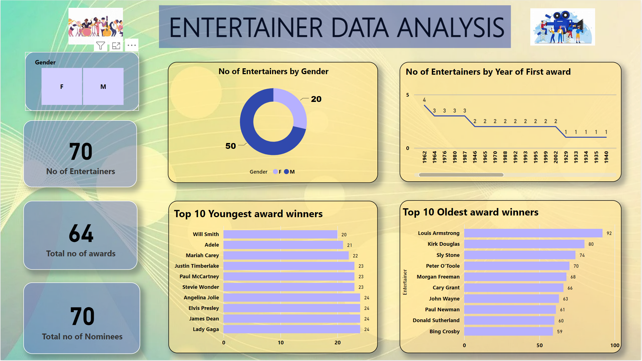
Awards Analysis -Dashboard

Slide 8
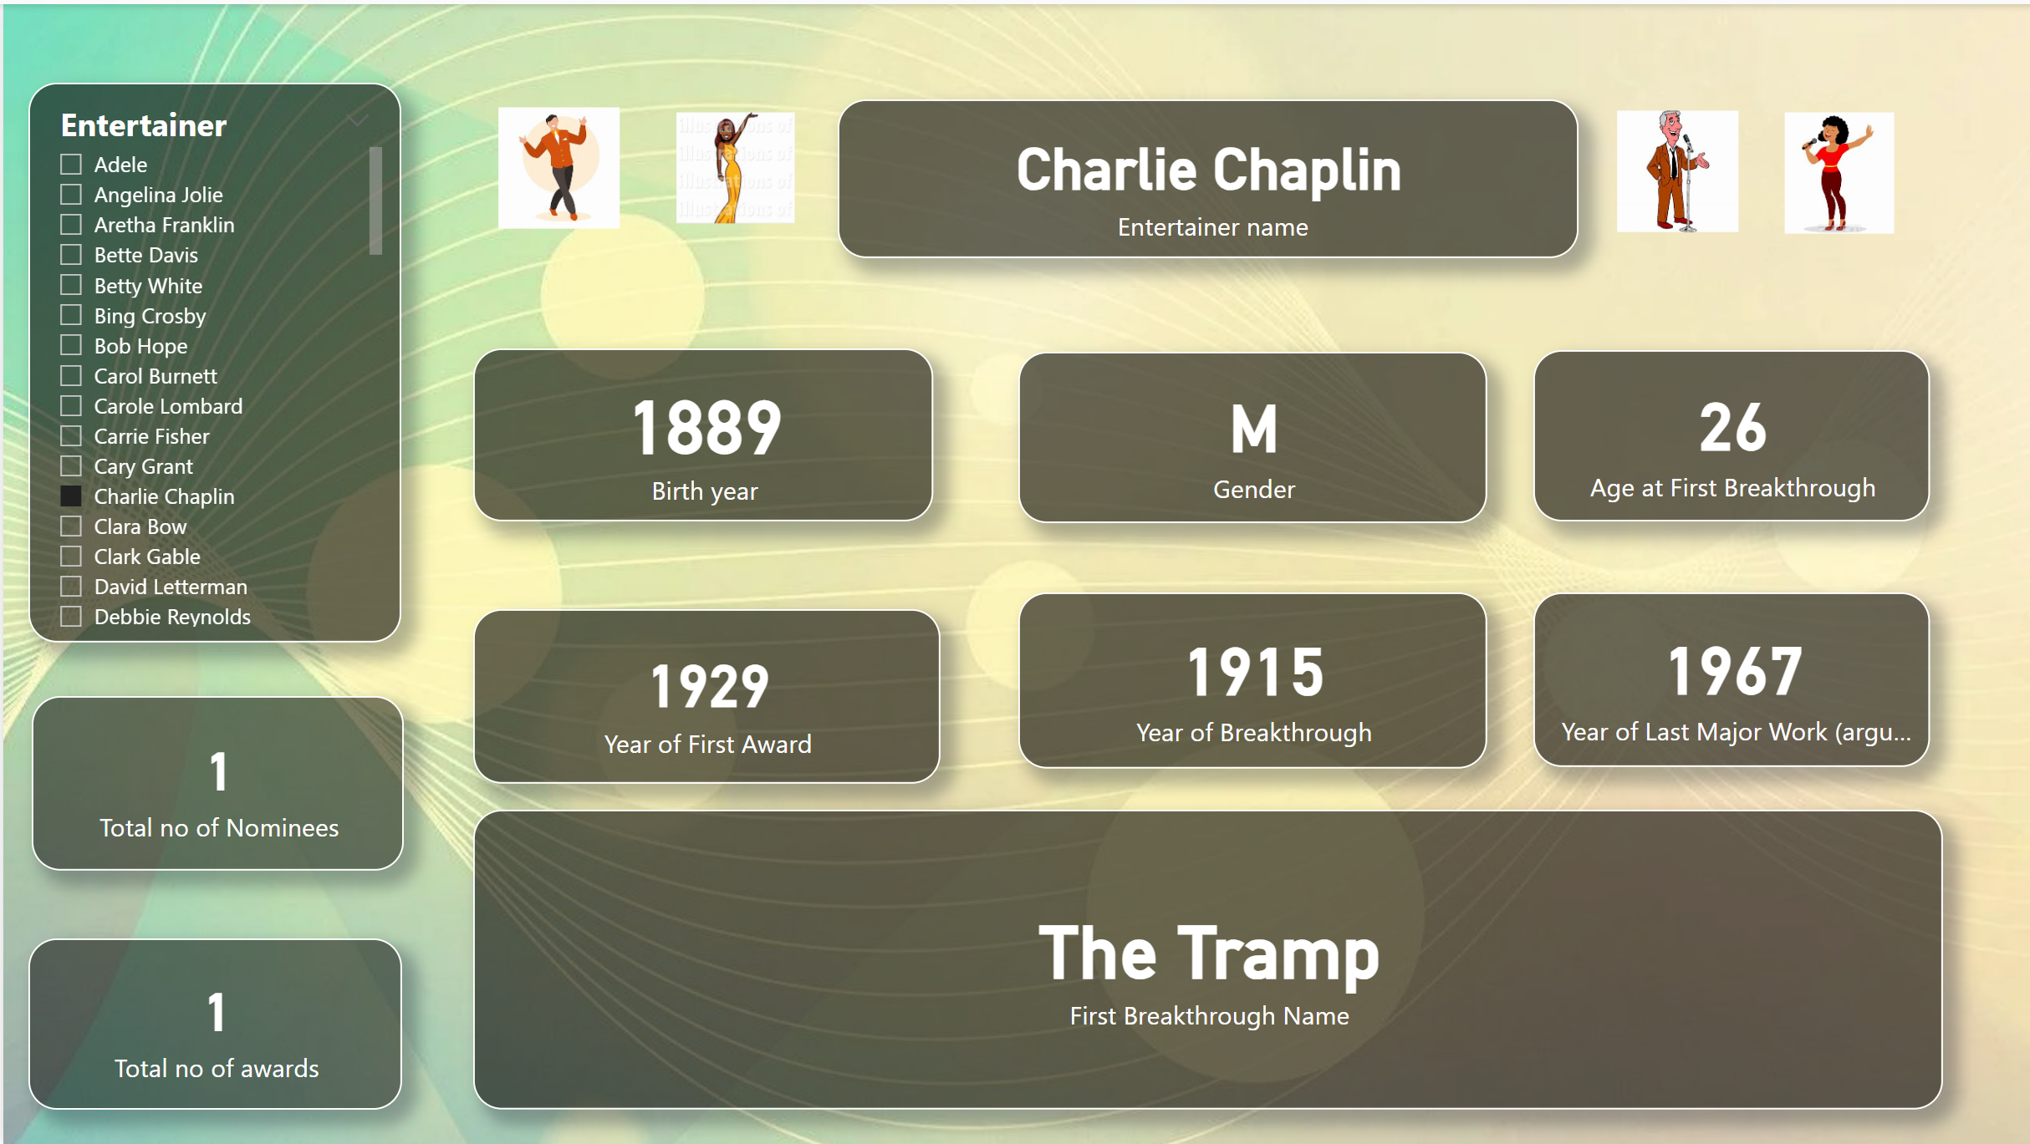
Profile Analysis - Dashboard

Slide 9
OBSERVATIONS
In the given Dataset, there are 50 male entertainers
20 of them are female entertainers.
The year 1962 tops with 4 awardees from the entertainers list.
19 Entertainers have won the award belove 30 years of age.
9 entertainers have won their first award above 60 years of age
4 entertainers have won their first award in the same year of their breakthrough/nomination
64 Entertainers out of 70 have won their first award

Slide 10
CONCLUSION
By analyzing this data, we gained valuable insights into the lives and careers of entertainers. Whether you’re a fan or just curious about the entertainment industry, understanding these details can be both fascinating and enlightening!

Slide 11
THANK YOU

